Slide 1
“SHOW ME” COVID DATA!
EXAMINING THE RATES OF COVID-19 ACROSS POPULATIONS IN THE COUNTIES OF MISSOURI
Katherine Comfort-Mason, Melissa Memel, David Ruppel & Christopher Wecke

Slide 2
MOTIVATION
The group wanted to choose a topic that met 2 conditions:
Relevant subject matter
Personal experience with subject matter
All conversations eventually led back to COVID-19.
We wanted to compare COVID-19 rates (Cases, Deaths, Mortality Rate) across Missouri (defined scope) using these variables:
Population density
Median income
Percent of population over 65
Percent of population without health insurance
Percent of population under the poverty line

Slide 3
Data sources
There is no shortage of COVID-19 data!
This made it difficult to narrow down the search.
We initially looked at any source for Covid-19 data. We discovered the NYTimes, a SLU professor, Chris Prener, MO data. Additionally we looked at health.mo.gov and meric.mo.go/data for county size, insurance,
The NYTimes data was used by the SLU professor, Chris Prener.
The SLU data also included data from the Missouri Covid Tracking Project
The data we did use had an incredible amount of columns, hospital bed capacity, beds in use, icu beds, number of hospitals reporting and number of those that aren’t, total tests, area of county, race percentages, percentage that carpool vs those that do not, percentage with various degrees.
We began exploring several repositories of data before finding 2 primary sources:
https://covidcountydata.org/
US Census County List

Slide 4
Data cleaning
Covid County Data API allowed us to combine Covid datasets with the county-level demographic data.
The only thing missing from the dataset was the county name.
This was pulled from the US Census Bureau county dataset using the FIPS ID.
This caused issues since the FIPS ID in one dataset was an integer and the other was an object.
Converting the FIPS to an object was difficult because the leading zeroes were necessary (not for Missouri, but for the entire US dataset).
We were not successful, mainly due to the fact that the MO data was fine (no leading zeroes), so the team decided it was not worth the effort.

Slide 5
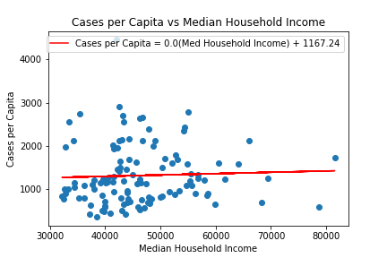
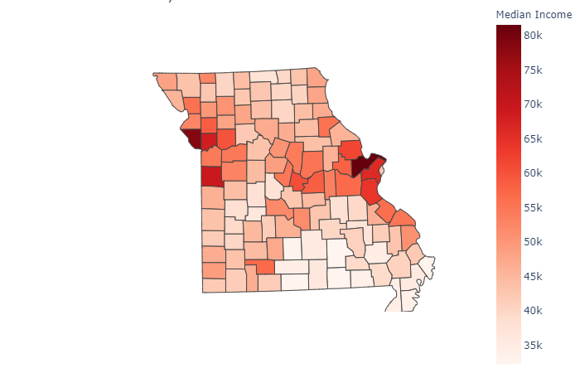
Cases per capita vs. Median household income
Covid County Data API allowed us to combine Covid datasets with the county-level demographic data.
The only thing missing from the dataset was the county name.
This was pulled from the US Census Bureau county dataset using the FIPS ID.
This caused issues since the FIPS ID in one dataset was an integer and the other was an object.
Converting the FIPS to an object was difficult because the leading zeroes were necessary (not for Missouri, but for the entire US dataset).
We were not successful, mainly due to the fact that the MO data was fine (no leading zeroes), so the team decided it was not worth the effort.

Slide 6
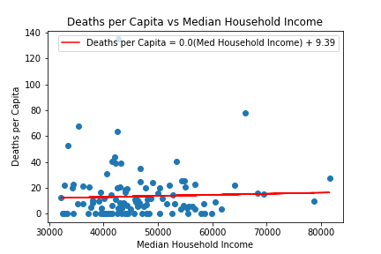
deaths per capita vs. Median household income

Slide 7
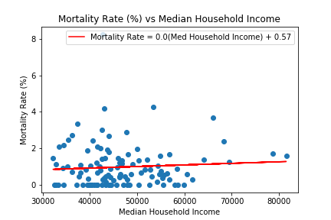
Mortality rate vs. Median household income

Slide 8
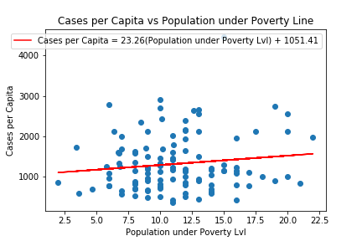
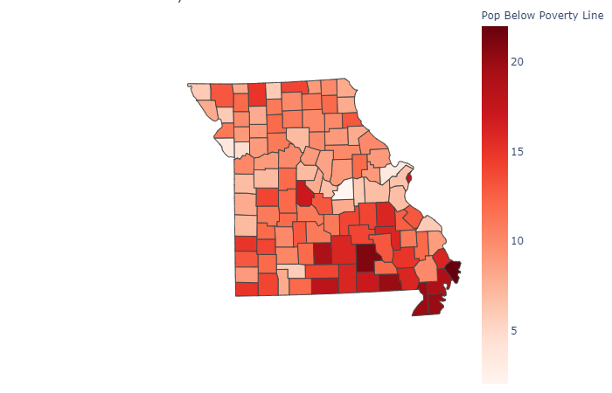
Cases per capita vs. pop. Below poverty line

Slide 9
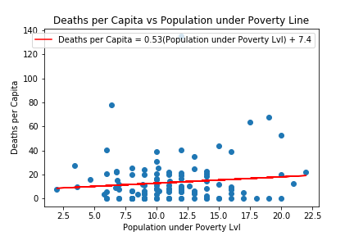
deaths per capita vs. pop. Below poverty line

Slide 10
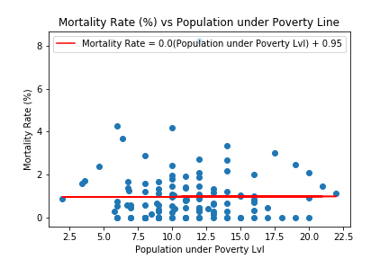
Mortality rate vs. pop. Below poverty line

Slide 11
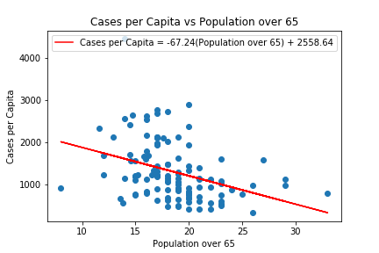
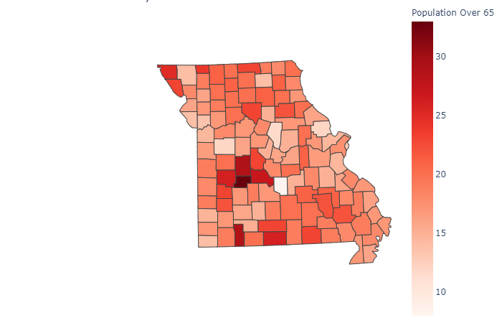
Cases per capita vs. Population age 65+
Notes:
No. 1 – Hickory County – 33% over 65

Slide 12
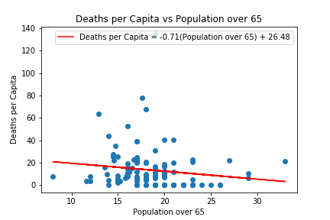
deaths per capita vs. Population age 65+

Slide 13
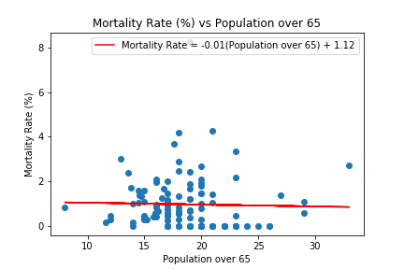
Mortality rate vs. Population age 65+

Slide 14
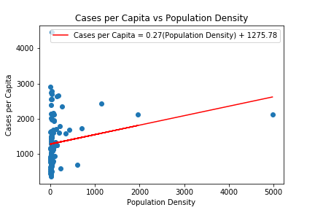
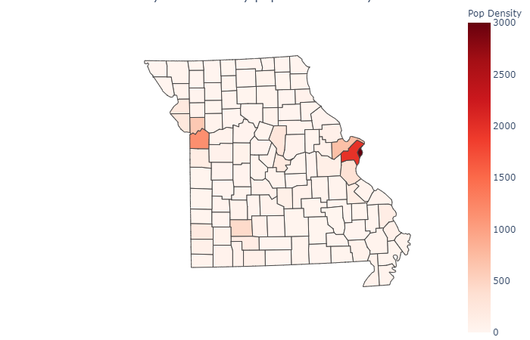
Cases per capita vs. population density

Slide 15
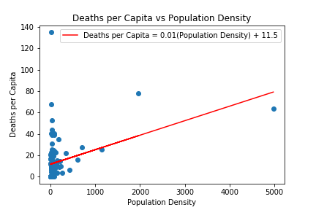
deaths per capita vs. population density

Slide 16
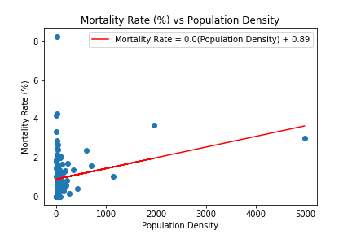
Mortality rate vs. population density
Notes:
Top areas – STL and KC metro areas.

Slide 17
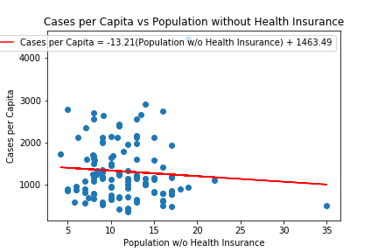
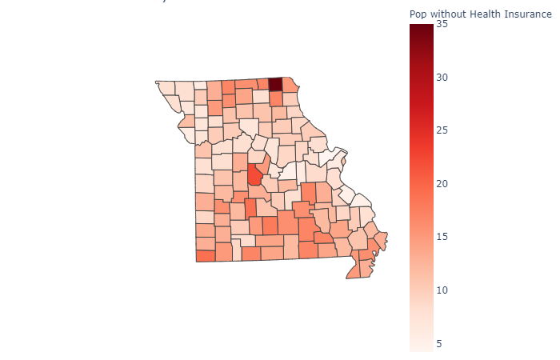
Cases per capita vs. uninsured population
Notes:
No. 1 – Scotland County (35%)
No. 2 – Morgan County (22%)

Slide 18
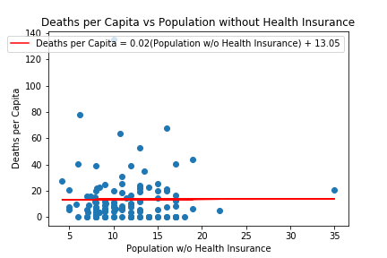

deaths per capita vs. uninsured population

Slide 19
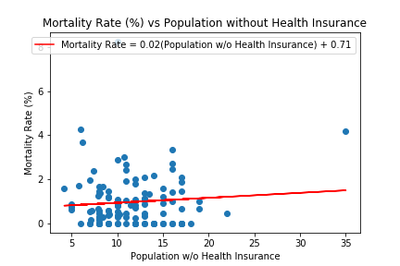
Mortality rate vs. uninsured population

Slide 20
Conclusion
There were several shortcomings of our project, primarily the lack of individual result analysis and comparison to state, region, national, and global metrics
Even with the flaws of our study, the results show that COVID-19 does not discriminate
However, we postulate that correlation was not presented due to the following:
Age above 65: Population not venturing into public for potential exposure
Uninsured: Without insurance, population less likely to seek medical attention i.e. COVID-19 testing
Median Income: As a group, we supposed that the poverty line variable would have been more significant and more accurate than median income, but that did not prove out. Most likely due to a potential correlation with uninsured rate (another gap in the study)

